Slide 1

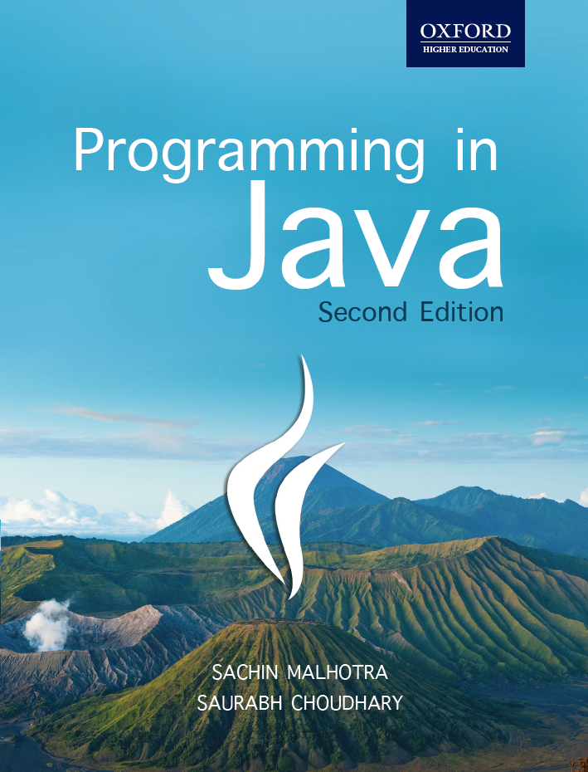
Programming in Java, 2e
Sachin Malhotra
Saurabh Choudhary

Slide 2
Chapter 6
Interface, Packages and Enumeration

Slide 3
Objective
Understand what interfaces are and how they are different from abstract classes
Understand the concept behind packages and how they are used
know about the java.lang package
Understand Object and Wrapper class
Understand how Strings are created, manipulated, and split in Java
Understand enumerations

Slide 4
Interfaces
Interfaces is a collection of methods which are public and abstract by default.
The implementing objects have to inherit the interface and provide implementation for all these methods.
multiple inheritance in Java is allowed through interfaces
Interfaces are declared with help of a keyword interface

Slide 5
Syntax for Creating Interface
interface interfacename
{
returntype methodname(argumentlist);
…
}
The class can inherit interfaces using implements keyword
class classname implements interfacename{}

Slide 6
Interface Example
interface Calculator {
int add(int a,int b);
int subtract(int a,int b);
int multiply(int a,int b);
double divide(int a,int b);
}

Slide 7
Example (contd.)
class Normal_Calculator implements Calculator
{
public int add(int a,int b){
return a+b;}
public int subtract(int a,int b){
return a-b;}
public int multiply(int a,int b){
return a*b;}
public int divide(int a,int b){
return a/b;}
public static void main(String args[]){
Normal_Calculator c=new Normal_Calculator();
System.out.println(“Value after addition = “+c.add(5,2));
System.out.println(“Value after Subtraction = “+c.subtract(5,2));
System.out.println(“Value after Multiplication = “+c.multiply(5,2));
System.out.println(“Value after division = “+c.divide(5,2)); }}

Slide 8
The Output
Value after addition = 7
Value after Subtraction = 3
Value after Multiplication= 10
Value after division = 2

Slide 9
Variables in Interface
They are implicitly public, final, and static
As they are final, they need to be assigned a value compulsorily.
Being static, they can be accessed directly with the help of an interface name
as they are public we can access them from anywhere.

Slide 10
Extending Interfaces
One interface can inherit another interface using the extends keyword and not the implements keyword.
For example,
interface A extends B { }

Slide 11
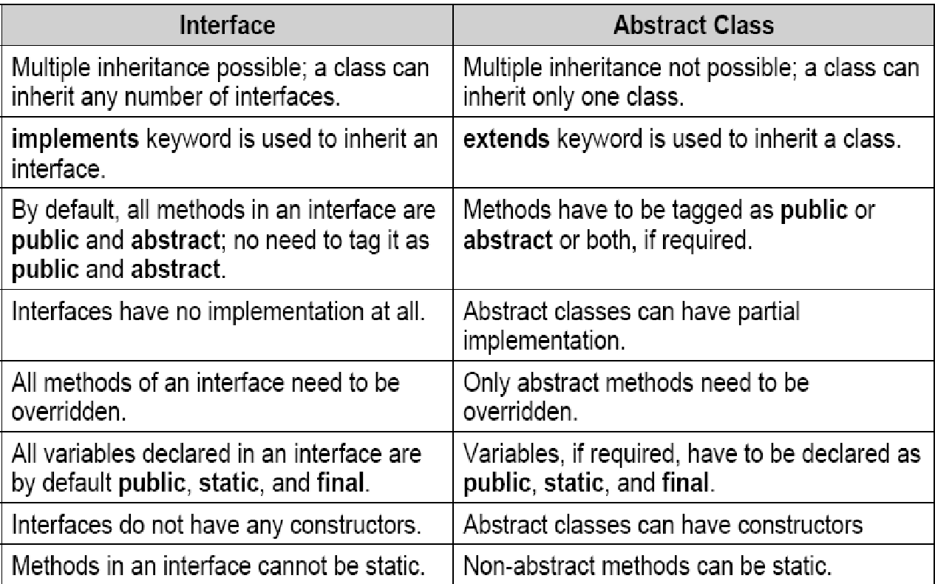
Interface Vs Abstract class

Slide 12
Similarities Between Interface and abstract class
Both cannot be instantiated, i.e. objects cannot be created for both of them.
Both can have reference variables referring to their implementing classes objects.
Interfaces can be extended, i.e. one interface can inherit another interface, similar to that of abstract classes (using extends keyword).
static / final methods can neither be created in an interface nor can they be used with abstract methods.

Slide 13
Access Modifiers
Access Modifier | Same Class | Same Package | Subclass (Different Package) | Other Packages
private | ✅ Yes | ❌ No | ❌ No | ❌ No
default (no keyword) | ✅ Yes | ✅ Yes | ❌ No | ❌ No
protected | ✅ Yes | ✅ Yes | ✅ Yes | ❌ No
public | ✅ Yes | ✅ Yes | ✅ Yes | ✅ Yes

Slide 14
Access Protection
Four Access specifier in Java
Why can't top-level class be private?
👉 Because it must be accessible to JVM to create objects.
An Inner Class is a class that is defined inside another class.
class Outer {
class Inner {
// inner class code
}
}
Access Modifier | Class | Variable | Method | Constructor | Inner Class
private | ❌ No | ✅ Yes | ✅ Yes | ✅ Yes | ✅ Yes
default | ✅ Yes | ✅ Yes | ✅ Yes | ✅ Yes | ✅ Yes
protected | ❌ No | ✅ Yes | ✅ Yes | ✅ Yes | ✅ Yes
public | ✅ Yes | ✅ Yes | ✅ Yes | ✅ Yes | ✅ Yes

Slide 15
Access Specifiers (contd.)
public means accessibility for all
private means accessibility from within the class only.
default (blank) access specifiers are accessible only from within the package
protected means accessibility outside the packages but only to subclasses.

Slide 16
Access Specifiers Example
Suppose x & y are package
A is a public class within package x
B is another class within package x
C is subclass of A in package x
D is subclass of A within package y
E is class within package y
abc() is a method with default access in class A
xyz() is a method with protected access specifier in class A
pqr() is a method with public access specifier in class A

Slide 17
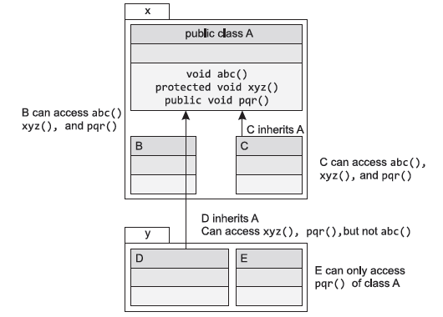
Access protection

Slide 18
Access protection

Slide 19
Access Protection (contd.)
method abc() is accessible from A, B as well as C, but neither from D nor E.
protected method are accessible outside the package also, but only to subclasses outside the package. For example, the method xyz() accessible from classes A, B, C, D, but not from E.
public method pqr() is accessible from all classes A, B, C, D and E

Slide 20
Packages
collection of classes and interfaces
provides a unique namespace for the classes.
declaration resides at the top of a Java source file.
A package can contain the following.
Classes
Interfaces
Enumerated types
Annotations

Slide 21
Example
package packexample;
public class ClassinPackage {
}
if you want to create sub-packages
package rootPackage.subPackage1;

Slide 22
Package (contd.)
Class that reside inside a package cannot be referred by their own name alone.
The package name has to precede the name of the class of which it is a part of.
All classes are part of some or the other package.
If the package keyword is not used in any class for mentioning the name of the package, then it becomes part of the default/unnamed package.

Slide 23
Compiling and executing packages
compiling the class
javac –d c:\pack ClassinPackage.java
executing the class
classpath needs to be set
Set CLASSPATH=%CLASSPATH%;c:\pack;
java packexample.ClassinPackage
Considering pack is the parent directory of packexample

Slide 24
Using Packages
Import keyword is used to import classes from a packages.
Any number of import statements can be given.
To import a single class
import java.awt.Rectangle;
To import all classes in a package (wild card notation)
import java.awt.*;
To import all the static members of the class
import static pkgName.ClassName.*;

Slide 25
Your Turn
Differentiate between interface and abstract class?
What is the significance of classpath in packages?
What is static import?
What are various access specifier in java?

Slide 26
java.lang package
java.lang is a imported by default in all the classes that we create.
Remember String and System class

Slide 27
Java.lang.Object class
parent by default of all the classes (predefined and user-defined) in Java.
The methods of Object class can be used by all the objects and arrays.
toString() and equals() are methods of Object class

Slide 28
toString() method
class Demo {
public String toString() {
return “My Demo Object created”;
}
public static void main(String args[]) {
System.out.println(new Demo()); }}
Output
My Demo Object created

Slide 29
Java Wrapper classes
For each primitive type, there is a corresponding wrapper class designed.
Are wrapper around primitive data types.
allow for situations where primitives cannot be used but their corresponding objects are required.
Normally Used to convert a numeric value to a String or vice-versa.
Just like String, Wrapper objects are also immutable
All the wrapper classes except Character and Float have two constructors—one that takes the primitive value and another that takes the String representation of the value.
Character has one constructor and float has three.

Slide 30
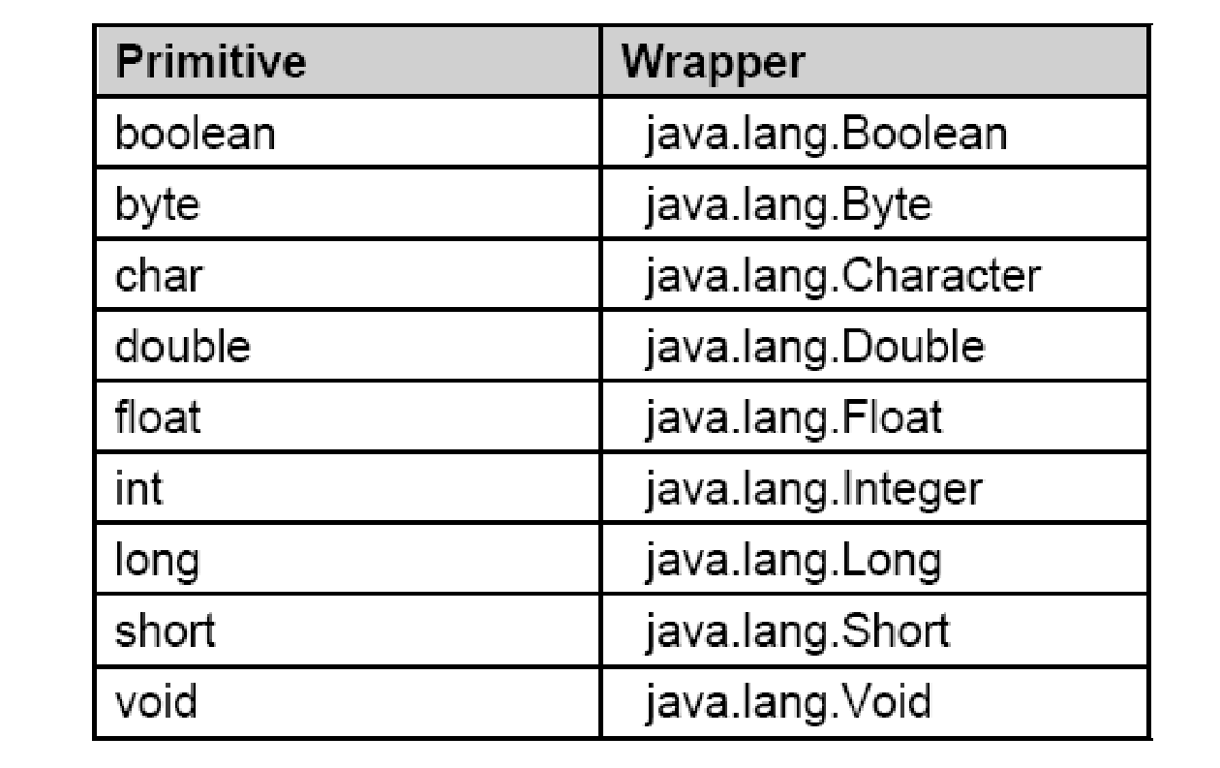
Wrappers classes

Slide 31
Wrapper classes (contd.)
converts primitive to wrapper
double a = 4.3;
Double wrp = new Double(a);
Each wrapper provides a method to return the primitive value.
double r = wrp.doubleValue();

Slide 32
Converting Primitive types to wrapper objects
Integer ValueOfInt = new Integer(v)
Float ValueOfFloat = new Float(x)
Double ValOfDouble = new Double(y)
Long ValueOfLong = new Long(z)
Where v, x, y and z are int, float, double, and long values, respectively.

Slide 33
Converting wrapper objects to primitives
int v = ValueOfInt.intValue();
float x = ValueOfFloat.floatValue();
long y = ValueOfLong.longValue();
double z = ValueOfDouble.doubleValue();

Slide 34
Converting primitives to String Object
String xyz = Integer.toString(v)
String xyz = Float.toString(x)
String xyz = Double.toString(y)
String xyz = Long.toString(z)

Slide 35
Converting back from String Object to Primitives
int v = Integer.parseInt(xyz)
long y = Long.parseLong(xyz)
public float parseFloat(String x)
public double parseDouble(String x)
public double parseByte(String x)
public double parseShort(String x)
May throw NumberFormatException if the value of the String does not represent a proper numbers

Slide 36
Converting Primitives represented by String to wrapper
Double ValueOfDouble = Double.valueOf(xyz);
Float ValueOfFloat = Float.valueOf(xyz);
Integer ValueOfInteger = Integer.valueOf(xyz);
Long ValueOfLong = Long.valueOf(xyz);
Double ValueOfDouble = Double.valueOf(xyz);
Float ValueOfFloat = Float.valueOf(xyz);
Integer ValueOfInteger = Integer.valueOf(xyz);
Long ValueOfLong = Long.valueOf(xyz);
String argument method generates a NumberFormatException in case the value in a String does not contain a number.

Slide 37
Autoboxing and Unboxing
Introduced in Java 5
conversion from primitives to wrappers is known as boxing, while the reverse is known as unboxing.
Integer wrap_int = 5;
primitive 5 autoboxed into an Integer
int prim_int = wrap_int;
automatic unboxing Integer into int

Slide 38
String class
are basically immutable objects in Java.
Immutable means once created the, strings cannot be changed.
Whenever we create strings, it is this class that is instantiated.
In Java strings can be instantiated in two ways:
String x= “String Literal Object”;
String y=new String (“String object is created here”);

Slide 39
String Example
String a=”Hello”; String b=”Hello”;
String c=new String(“Hello”);
String d=new String(“Hello”);
String e=new String(“Hello, how are you?”);
if(a==b)
System.out.println(“object is same and is being shared by a & b”);
else
System.out.println(“Different objects”);
if(a==c)
System.out.println(“object is same and is being shared by a & c”);
else
System.out.println(“Different objects”);

Slide 40
String Example
if(c==d)
System.out.println(“same object”);
else
System.out.println(“Different objects”);
String f=e.intern();
if(f==a)
System.out.println(“Interned object f refer to the already created object a in the pool”);
else
System.out.println(“Interned object does not refer to the already created objects, as literal was not present in the pool. It is a new object which has been created in the pool”);
we have omitted the class and the main method declaration from this example. You need to add it to run the example (refer Book for complete program).

Slide 41
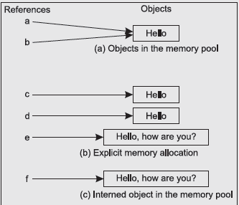
String Example

Slide 42
The Output
object is same and is being shared by a & b
Different objects
Different objects
Interned object does not refer to the already created objects, as literal was not present in the pool. It is a new object which has been created in the pool

Slide 43
String Manipulation
Strings in Java are immutable (read only) in nature, Once defined cannot be changed.
Let us take an example:
String x = “Hello”; // ok
String x = x +”World”; // ok, but how?
the ‘+’ operator concatenates If at least one of the operand is a string.
The second statement gets converted to the following statement automatically
String x=new StringBuffer(). append(x). append(“World”). toString();

Slide 44
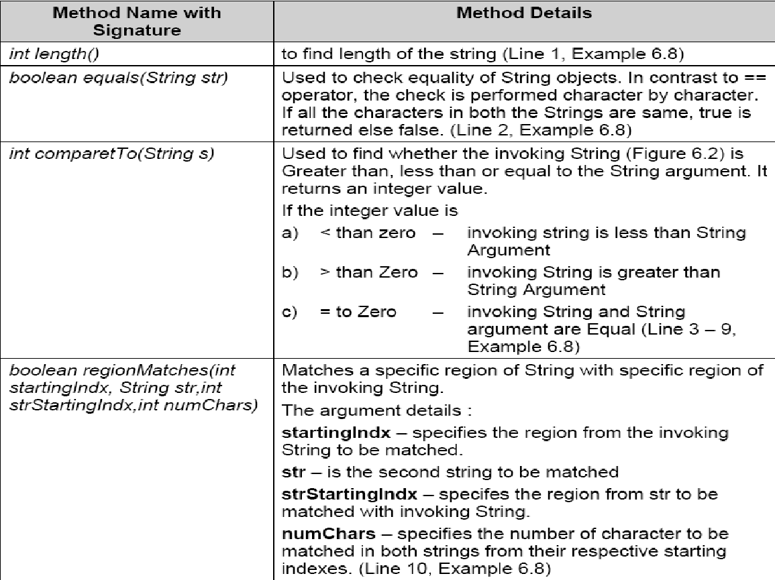
Common methods of the String class

Slide 45
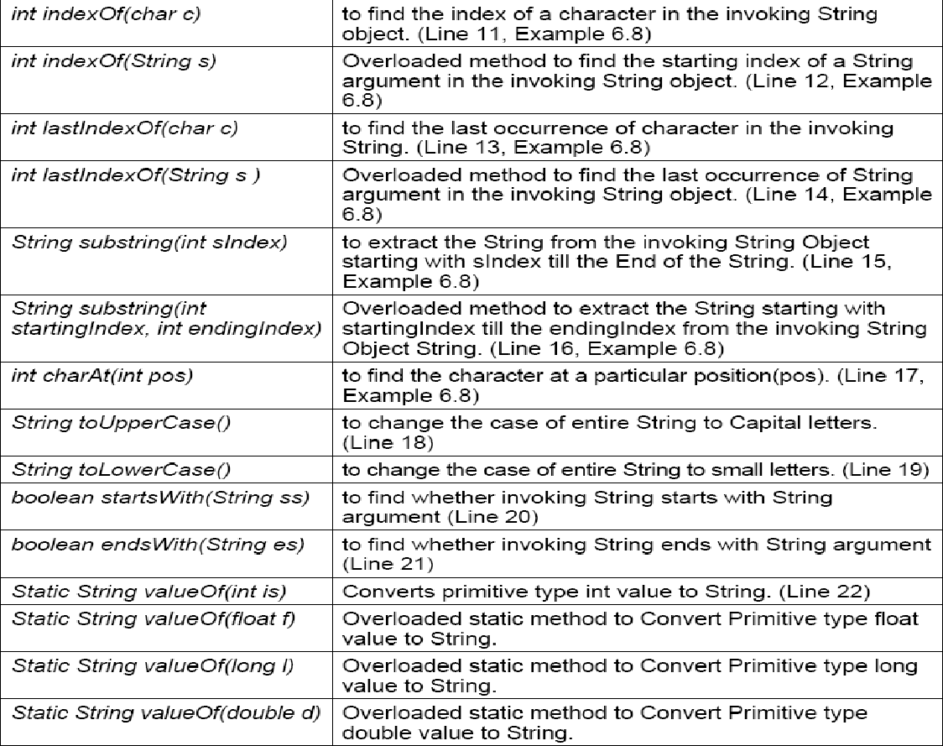
Methods of String class

Slide 46
StringBuffer class
StringBuffer class is used for representing changing strings.
StringBuffer offers more performance enhancement whenever we change Strings, because it is this class that is actually used behind the curtain.
Just like any other buffer, StringBuffer also has a capacity and if the capacity is exceeded, then it is automatically made larger.
The initial capacity of StringBuffer can be known by using a method capacity().

Slide 47
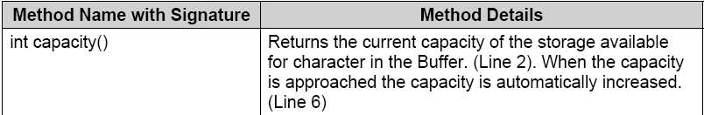
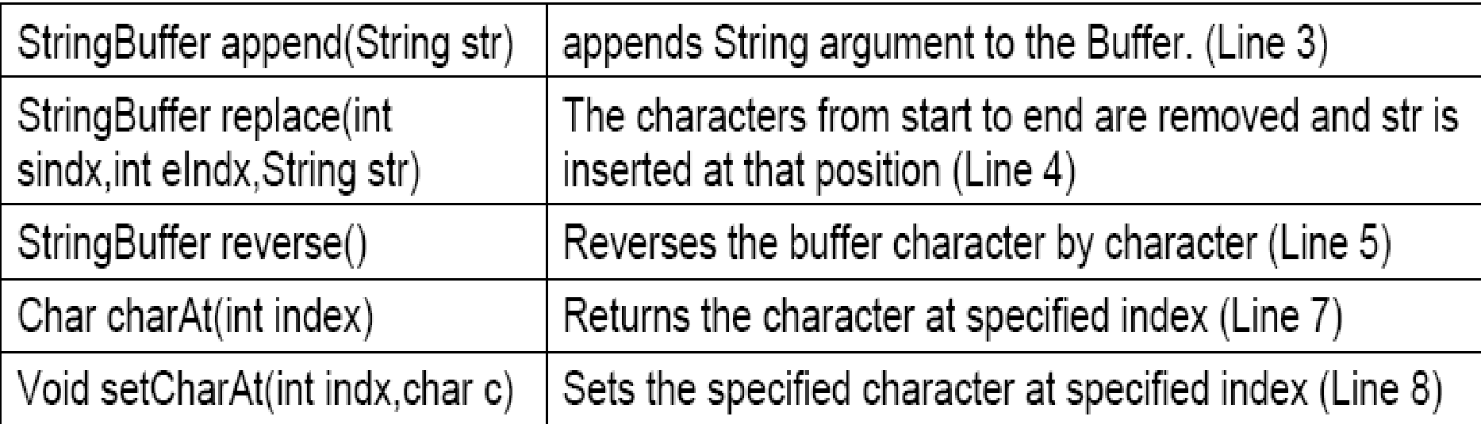
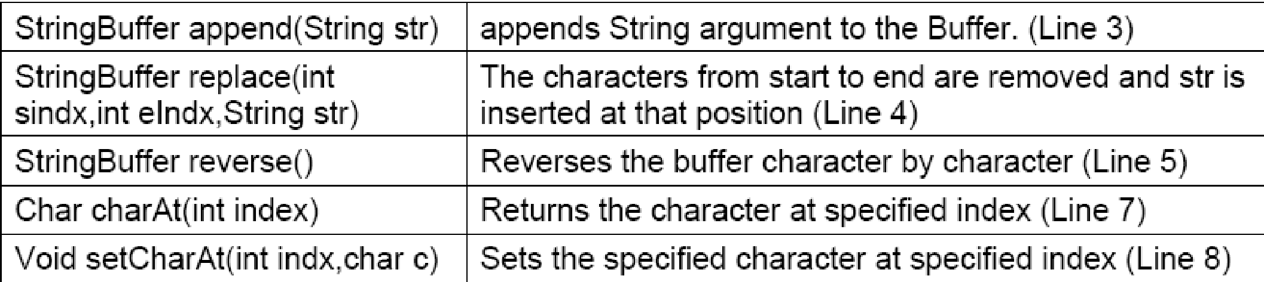
Methods of StringBuffer class

Slide 48
StringBuilder class
introduced in Java 5
a substitute of StringBuffer class.
This class is faster than StringBuffer class, as it is not synchronized
append(), insert(), delete(), deleteCharAt(), replace(), and reverse() return StringBuilder objects rather than StringBuffer objects.
The line creates a StringBuilder object.
StringBuilder s=new StringBuilder();
construct a StringBuilder object with an initial capacity of 16 characters. Similar to that of StringBuffer.

Slide 49
Splitting Strings
StringTokenizer is a utility class provided by the java.util package.
Now a legacy code.
This class used to be of utmost importance when we want to divide the entire String into parts (Tokens) on the basis of delimiters.
The delimiters can be any of the whitespace, tab space, semicolon, comma, etc.
J2SE 1.4 added split( ) method to the String class for simplifying the task of splitting a String and also added Pattern and Matcher classes in java.util.regex package.

Slide 50
Example
import java.util.*; import java.util.regex.*;
class StringTokenizerDemo {
public static void main(String args[]) {
int i=1;
String str=”Never look down on anybody unless you’re helping him up”;
System.out.println(“Splitting String Using StringTokenizer class”);
StringTokenizer tr=new StringTokenizer(str,” “);
while (tr.hasMoreTokens()) {
System.out.print(“Token “+i+” :”);
System.out.println(tr.nextToken());
++i; }
System.out.println(“Splitting String Using split() method”);
String[] tk=str.split(“ “);
for(String tokens: tk)
System.out.println(tokens);
Pattern p=Pattern.compile(“ “);
tk= p.split(str,3);
for(String tokens: tk)
System.out.println(tokens); }}

Slide 51
Enum Type
is a kind of class definition.
Subclass of Object class and inherits the Comparable interface
Defines the type along with the possible set of enum values which are listed in the curly braces, separated by commas
All enum types are subclasses of the java.lang.Enum class.
Each value in an enum is an identifier.
The following statement declares a type, named Games, with the values CRICKET, FOOTBALL, TENNIS, and BASKETBALL.
enum Games { CRICKET, FOOTBALL, TENNIS, BASKETBALL };
By convention, all names must be in upper case.

Slide 52
Enum (contd.)
Once a type is defined, you can declare a variable of that type:
Games G;
G can hold one of the values defined in the enumerated type Games or null, but nothing else.
An attempt to assign a value other than the enumerated values or null will result in a compilation error.
The enumerated values can be accessed using the syntax.
enumeratedTypeName.valueName
G = Games.TENNIS;

Slide 53
Enum Example
public class EnumDemo {
static enum Games {CRICKET, FOOTBALL, CHESS, BASKETBALL, TENNIS,BADMINTON};
public static void main (String[] args) {
Games G1 = Games.CHESS;
Games G2 = Games.TENNIS;
System.out.println(“First game is “ +G1.name());
System.out.println(“Second game is “ +G2.name());
System.out.println(“First game’s ordinal is “ +G1. ordinal());
System.out.println(“Second game’s ordinal is “ +G2.ordinal());
System.out.println(“G1.equals(G2) returns “ +G1. equals(G2));
System.out.println(“G1.toString() returns “ +G1. toString());
System.out.println(“G1.compareTo(G2) returns “+G1.compareTo(G2)); }}

Slide 54
The output
First game is CHESS
Second game is TENNIS
First game’s ordinal is 2
second game’s ordinal is 4
G1.equals(G2) returns false
G1.toString() returns Chess
G1.compareTo(G2) returns -2

Slide 55
for Loop with Enumeration
Each enumerated type has a static method values( ) associated with them that returns all enumerated values for the type in an array.
For example,
Games[] G = Games.values();
You can use for loop to process all the values in the array.
for (int i = 0; i < G.length; i++)
System.out.println(G[i]);

Slide 56
Conditional Statements with Enumeration
can use if or switch-case with Enumerations to test the value in the variable, as shown below.
If Statement:
if (G1.equals(Games.CRICKET)) {
// action to be performed
} else if (G1.equals(Games.FOOTBALL)) {
// action to be performed
} else ....

Slide 57
Conditional Statements with Enumeration
Switch Statement:
switch (Games) {
case CRICKET: // case CRICKET and not // Games.CRICKET
// action to be performed;
case FOOTBALL:
// action to be performed;
...
}

Slide 58
Attributes and Methods within Enumeration
public enum Desc {
CRICKET (“Sachin Tendulkar”), CHESS (“Vishwanathan Anand”), TENNIS (“Sania Mirza”);
private String description;
private Desc(String description) {
this.description = description; }
public String getDesc() {
System.out.print(“Indian Delight: “);
return description; } }
public class UseDesc {
public static void main(String[] args) {
Desc player = Desc.TENNIS; System.out.println(player.getDesc());
}}

Slide 59
Summary
Java does not support multiple inheritance among classes.
Multiple inheritance can be done using interfaces.
Classes can be grouped together to form a Package.
Package is a collection of java files similar to a directory.
A fundamental predefined package is discussed in this chapter: java.lang package.
For all the primitive data types, wrapper classes are defined which encapsulate the functionality of the primitive data types.

Slide 60
Summary
A few other classes like Object, String, StringBuffer and StringBuilder class have been discussed, as these classes are frequently used in programming.
All classes, whether predefined or user-defined, inherit ultimately from the Object class implicitly.
Enum type is a kind of class and is basically useful when we know the type along with the possible set of values in that type.

